Slide 1
Why Do you Wear a Turban?
From westen’s point of view

Slide 2

How can a turban be related to any religion?”
I invited one person (about sixty years old) to come to the stage.
When he was standing by my side and everyone had their eyes and ears tuned to us, I addressed him, “May I request you, to take off your trousers
Everybody got silent and waited for the response from the man.
The man gave a polite answer.
In a low voice without expressing any anger or feeling insulted, he said, “No, it is against good manners.”

Slide 3

My purpose was achieved.
Immediately I apologized to him, “I am very sorry for my wrong request, and regret it sincerely,”
I referred to Ezekiel 44:18-19, where it is stated, “Once they enter the gates of the inner court they are to wear linen vestments; they should wear linen turbans and linen drawers on their loins.”
After explaining the importance of the messages of the Bible, I observed, “We should be thankful and obliged to our friend (pointing to the gentleman who was called to the stage).
He has explained to us, and very correctly so, that wearing trousers is good manners and now we all know that it is a requirement according to the Bible.

Slide 4
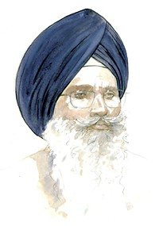
The quotation teaches us that all the three clothes, turban, vest and trousers are a religious requirement for every person. Removing any one of these three is ill-mannered
Sikhs are, therefore, required to wear all the three garments.”
I chose not to elaborate that according to the Bible removing turban, like taking off trousers, is also bad manners.
That would have hurt the self-esteem of the listeners.

Slide 5
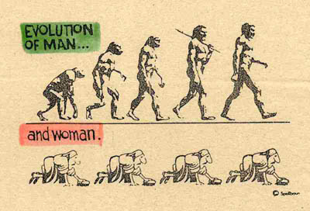

To conclude the discussion, I reminded them of the reverse change being wrought in the dress code of human beings by the modern half-baked philosophy.
“To begin with, you know, we lived naked like animals and roamed in the jungles for gathering our food.
We may call that stage as animal-man stage.
Slowly we developed our human behavior and human culture of wearing clothes.
Thus we became what we are today, humans (cultured man).

Slide 6
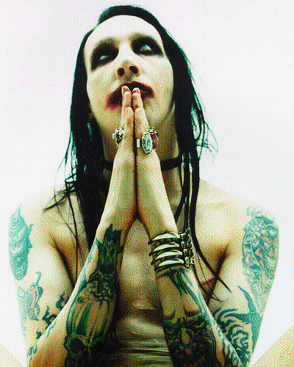
“Throwing away this human culture, which we have developed during the thousands of years of our history, means going back to the animal culture, or in other words becoming an animal-man again.
Because of the modern fashion to be clothe-less, some thinkers have formed nude colonies. There are dozens of them in Texas, USA, alone.

Slide 7
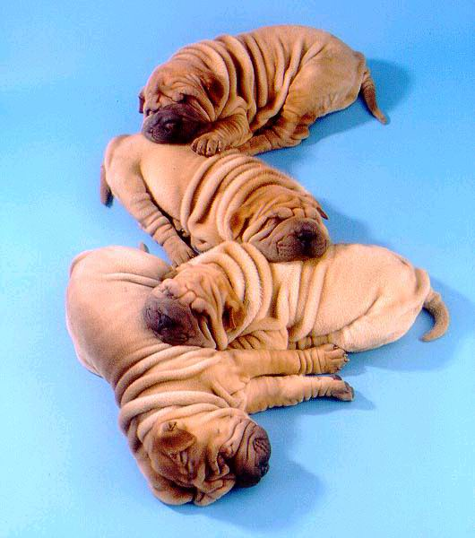
The culture of believing in religion also differentiates us from the four legged species.
They have no idea of spiritual life.
We, being religious persons, must follow the directions of theReligion and feel satisfied by living that way.
We should not slide back to the animal culture by giving up our religion.

Slide 8
Recommendation (and the logical justification for it) that we must live a religious life as directed by our scriptures pleased them all.
It very well fitted in their philosophy.
An additional lesson valuable for teaching their children the significance and necessity of respecting the principles of their faith.
They could argue with their children that without following religious code we slide down to the animal culture, and thus could convince them about the necessity of practising religion in their lives.

